Slide 1
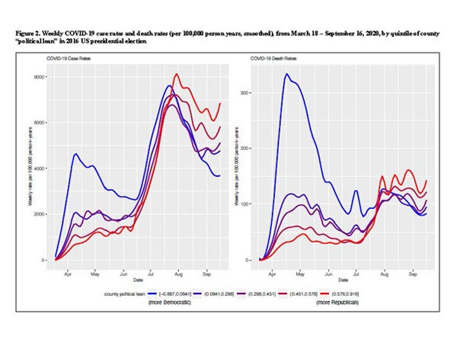
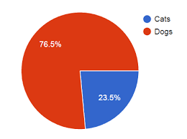
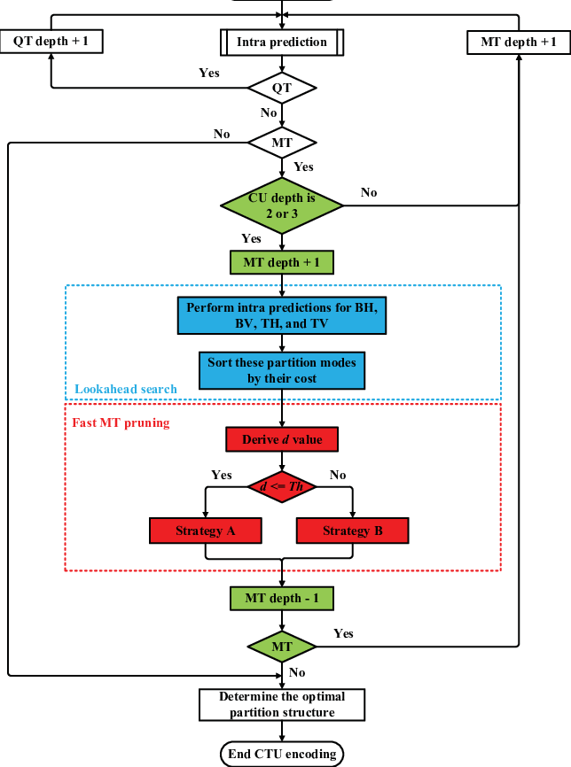
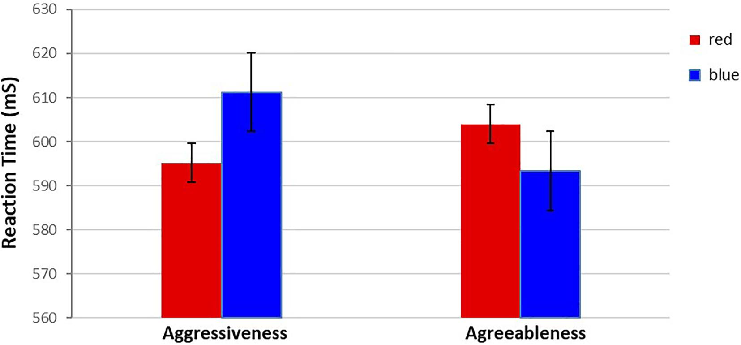
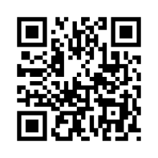
Poster Title Goes Here
Authors¹
¹Affiliations
Logo
Logo
Logo
Logo
Logo
Introduction
Results
Use incomplete sentences
Smallest size body text 36
Keep word count to minimum
Hypothesis:
Probe
Fig X: sentence long description of image/figure. Min size 18.
Fig X: sentence long description of image/figure. Min size 18.
Materials/Methods
Use incomplete sentences
Smallest size body text 36
Keep word count to minimum
Use incomplete sentences
Smallest size body text 36
Keep word count to minimum
Category | Results
Category 1 | #
Category 2 | #
Category 3 | #
Category 4 | #
Category 5 | #
Fig X: sentence long description of image/figure. Min size 18.
Fig X: sentence long description of image/figure. Min size 18.
Use incomplete sentences
Smallest size body text 36
Keep word count to minimum
Discussion/Conclusion
Acknowledgements
Use incomplete sentences
Smallest size body text 36
Keep word count to minimum
This is the one section you can use complete sentences to thank those that helped you on your project. Include whoever you would like. Additionally, don’t forget about your logos. You need the KEYS, BIO5, and Ken R. Coit College of Pharmacy logo and those required by your lab.
References

